Slide 1
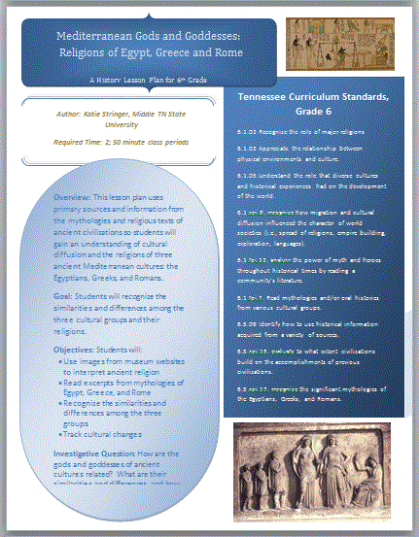
Classical and Public History
A Presentation for HIST 4410
By Katie Stringer

Slide 2
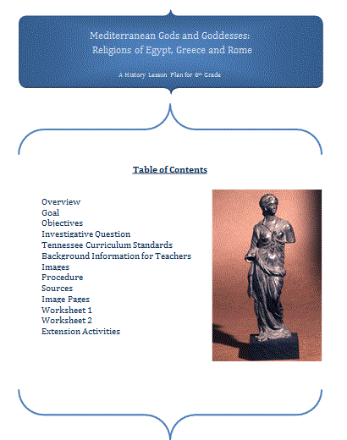
Purpose of this project
Curriculum based-project
To give teachers something fun and creative to present that they don’t have to plan by themselves
To inspire students to learn more about Classical and/or ancient history
Notes:
Why is curriculum based important?

Slide 3
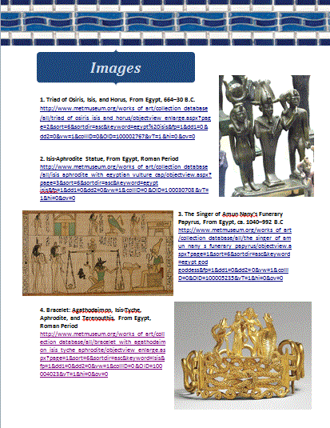
A lesson plan for 6th grade teachers…
Includes TN State Curriculum Standards
Background information for the teacher
Easy to follow, step-by-step instructions for the teacher
Primary source images from museum websites
More sources for the teacher and/or students
Extension activities for interested students or extended class periods

Slide 4
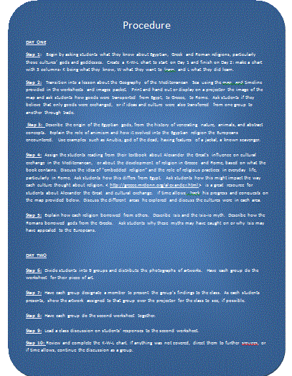
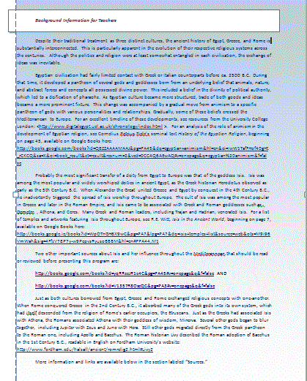
Let’s try this program out…
** You will not get the full experience that students who use the entire lesson plan will, because their teachers have 2 50-minute class periods to cover what we will really quickly go over. Sorry! **

Slide 5
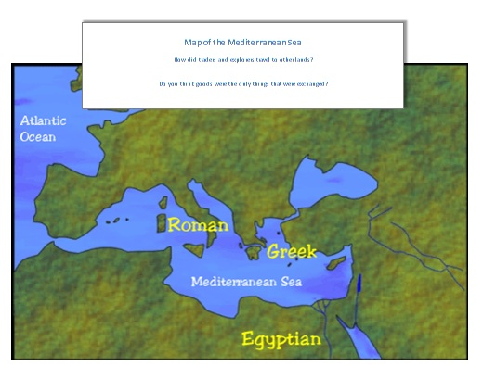

Slide 6
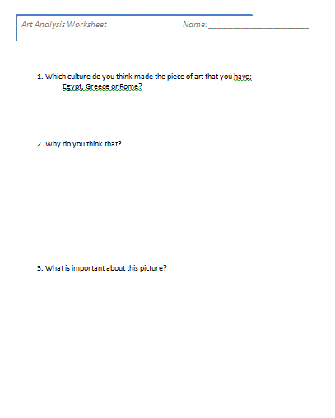
Worksheet 1
Divide into 9 groups (2 or 3 students per group)
Each group gets a photo of the primary source and a worksheet.
Fill out the worksheet.
Discussion:Fun or not?
  Difficult or easy?
  Did you learn anything?

Slide 7
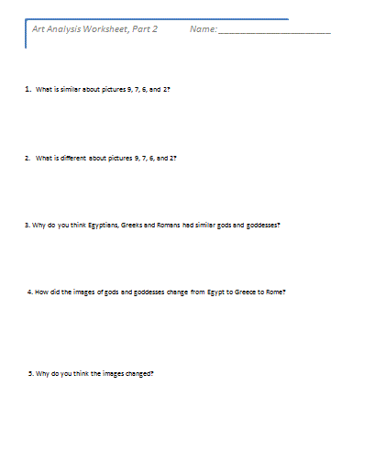
Part Two
Discuss your picture and the answers on your worksheet with your classmates
Do Worksheet Part 2
Discussion:
  Fun or not?
  Difficult or easy?
  Did you learn anything?

Slide 8
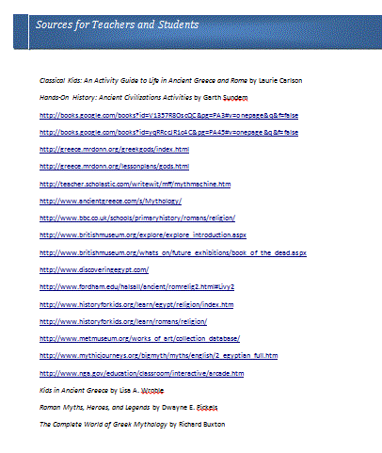
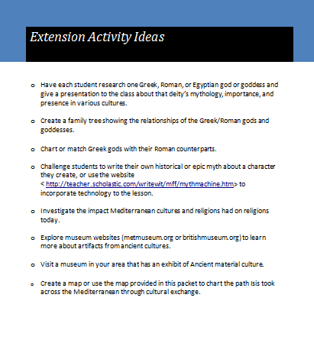
More information…

Slide 9
Any elementary or secondary education majors?
If you are an education major, would you use this program in the classroom?
As a 6th grade student, how would you feel about this lesson plan? Fun? Boring? Lame? Exciting?

Slide 10
How is this related to public history?
Discussion!
What is public history?
Why is it important?
Do you think Public history is applicable to the ancient or classical world?
What are some ways that we have learned in this class that the public uses (or abuses?) history?
Notes:
Classical Nashville, vegas and forum/luxor/caesar’s palace for discussion – Who has been to vegas?
Are these things just silly or could they have a purpose/reason?
Plug the blog here – use a clip from history teachers if have time??

Slide 11
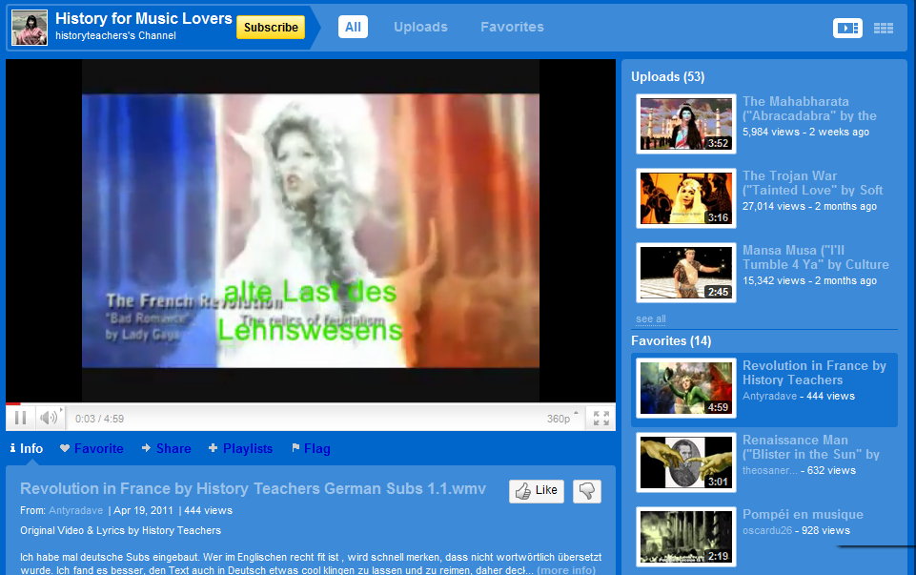
If we have time…
… A pretty funny example of public history/creative curriculum at work – great use of pop culture!
You choose:
Beatles (Odyssey)
Or
Radiohead (Minoans)
Or
Mambo #5 (Rome)
Discussion:
Negatives? Positives?

Slide 12
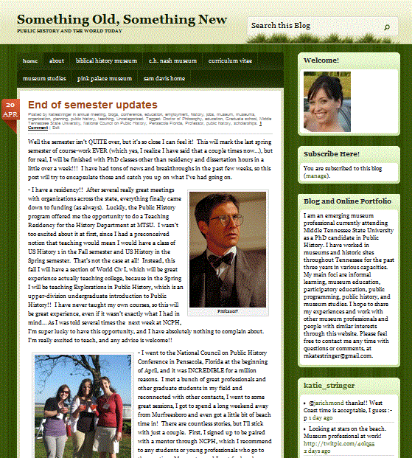
If you are interested in learning more about Public History…
Email me (mks2x@mtmailmtsu.edu)
OR
Check out my blog at
http://katiestringer.wordpress.com

